Slide 1
Annual General Meeting
March 18, 2018
Estabrooks Community Hall
Notes:
(Harry at the podium)
Attention please!
I’d like to bring the meeting to Order and welcome you to the 17th Annual General Meeting of the Five Bridges Wilderness Heritage Trust.
For those who don’t know me, I’m Harry Ward, Board Chair.
Pleased to see so many familiar faces here today, looking forward to making new friends as well.
So welcome everyone.
(Hold Up a Membership Card)
If you haven’t already, I encourage you visit the Membership Desk to purchase an Annual Trust Membership today. It’s only $10 for individuals/$15 for family and we thank you and value your support. You’ll also see samples of some new branded promotional items. Price list is available and you can see Joanne Ellis to place an order. This is yet another way we can bring awareness to the Trust.
I hope you also got a draw ticket when you arrived. If you didn’t please let us know. We have some surprises planned for ticket winners.
(Politicians in the crowd?)

Slide 2
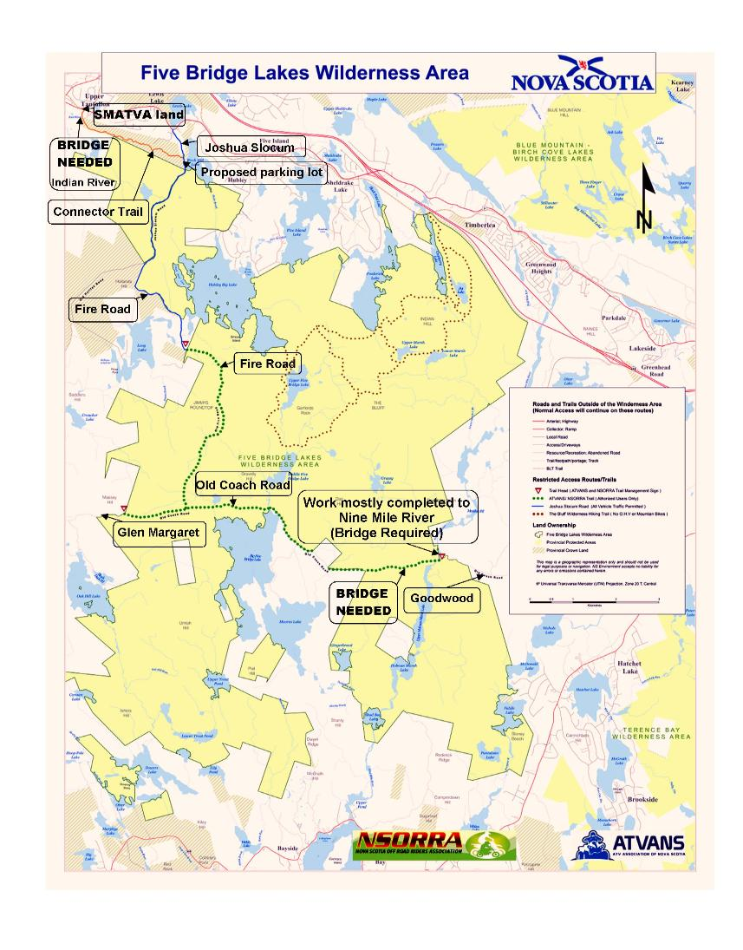
Agenda
Approval of Agenda
Approval of Minutes
for 2017 AGM
Treasurer’s Report
Report from the Chair
Report from the Nominating Committee
Guest speaker:
Butch Galvez
Adjournment
Notes:
Here is our Agenda for today’s AGM meeting.
Can I have a motion to approve the agenda?
Seconder?
Motion carried.

Slide 3
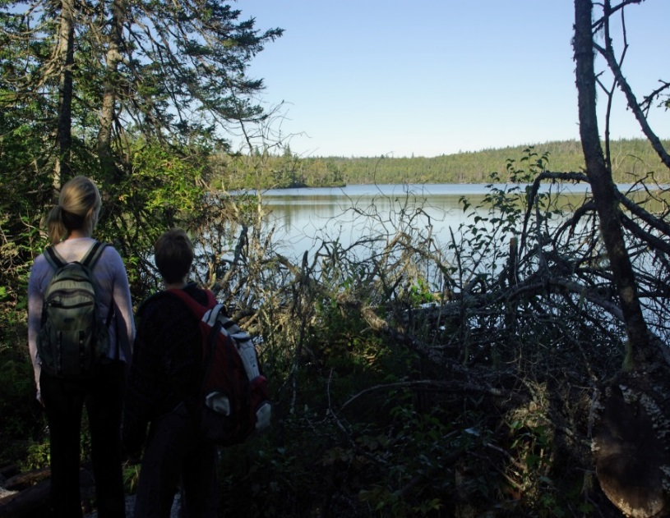
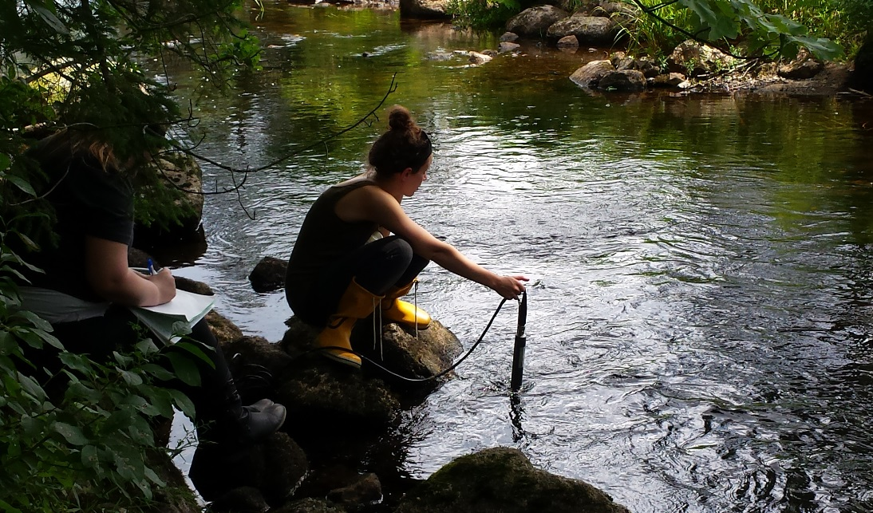
Approval of Minutes for 2017 AGM
Watch…Listen….Learn…Teach
Notes:
The Meeting Minutes for the 2017 AGM have been presented.
Can I have a motion to approve last year’s Minutes?
Seconder?
Motion carried.
Please welcome Trust Treasurer Bridget Adams to the front. She’ll be delivering the Treasurer Report. (Harry steps aside)

Slide 4
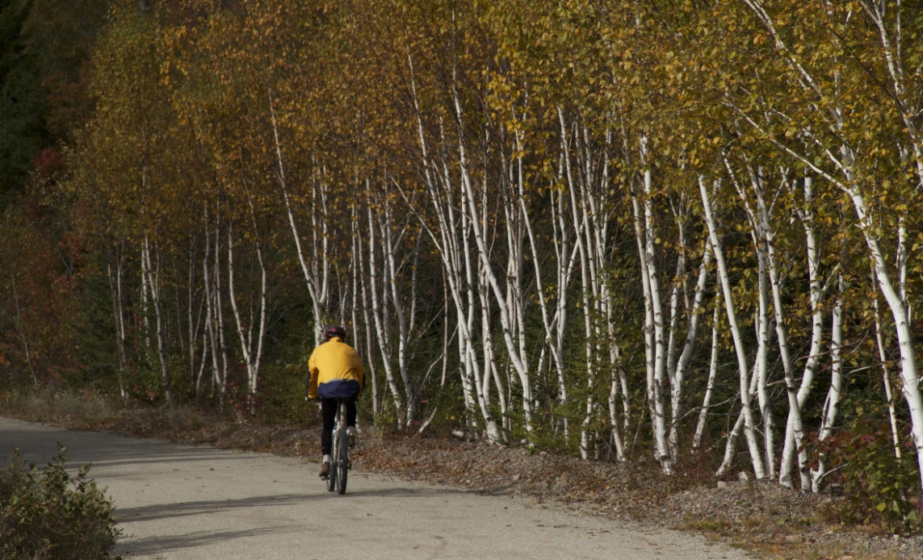
Treasurer’s Report
Notes:
(Bridget steps to the podium)
Thanks Harry. Good afternoon everyone.
Copies of our Financial Statements for 2017 are available in the provided handouts.
From the Statement of Financial Position, dated December 31, 2017.
Assets
CURRENT ASSETS
Cash $70,325
Accounts receivable $13,943
-------------
$84,268
Liabilities
CURRENT LIABILITIES
Accounts payable $ 1,649
UNRESTRICTED $82,619
$82,619
$84,268
------------
------------
Can I have a motion to approve the Treasurer’s Report?
Seconder?
Motion carried.

Slide 5
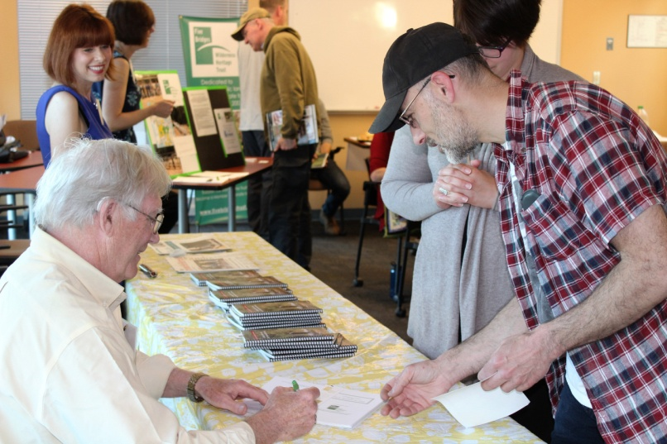
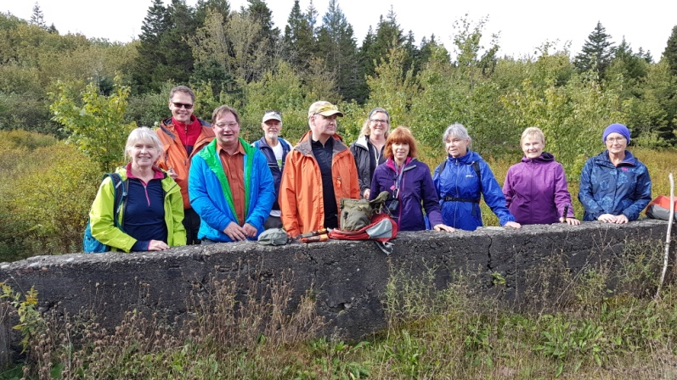
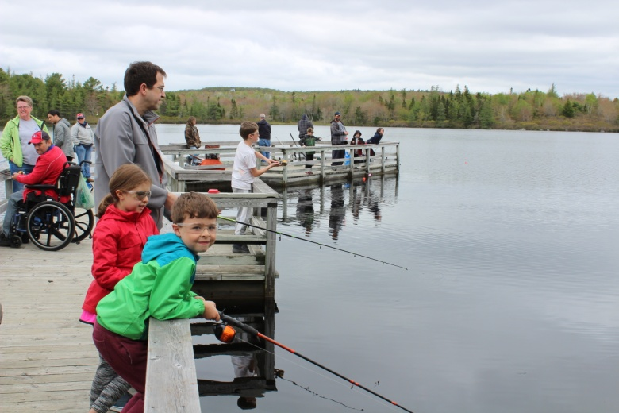
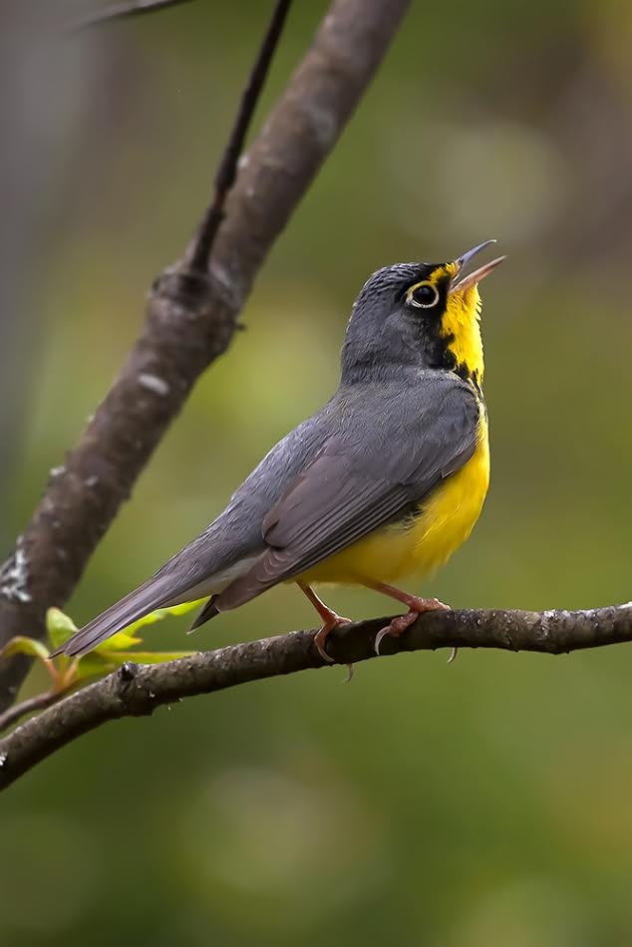
Report from the Chair
Members – Join us
Walking Guide
May Fair
Warbler Walk
Fall Hike to Cemeteries
Notes:
(Harry returns to the podium)
As Chair, I get to share the great work of our volunteer team. But, we really are a team and we have a lot of fun. We certainly learn new things, make new friends and get great satisfaction from accomplishing our work. If you are interested in joining us a volunteer, we would love to have you. That’s my pitch. Now on with the news!
Last year, we shared 4,000 free copies of the second edition printing of A Walking Guide to the Old St. Margaret’s Bay Road. We hosted 4 book launches at local libraries and community centres. Met hundreds of people who were interested in exploring the landscape and history of this area. We gave copies to schools, Girl Guides, Scouts and other community organizations. Many thanks to the volunteers who helped complete the second edition project.
(Hold Up a Copy)
The public also donated to the Trust at these events once they realized the quality of this book, which were you to buy it at Chapter’s would cost you $30 bucks - easily. Let’s just say overall the project was a big hit.
Other hits included, the 11th Annual May Fair in the Park at Jerry Lawrence. For the first time at this event, we had so many hungry people we actually used all the hot dogs! Learn to Fish was a popular new addition to the event using the dock and the lake to teach families. More than 150 came out, which was a lot of fun.
With help from local birder, Hans Toom we also hosted the annual Warbler Walk event at Jerry Lawrence, which happens to be a key nesting site for warblers in Nova Scotia.
For the first time last September, we partnered with Halifax Meet-Up Group and Trust member Krista Whitehouse for a great Fall Hike to the cemeteries described in the Walking Guide.

Slide 6
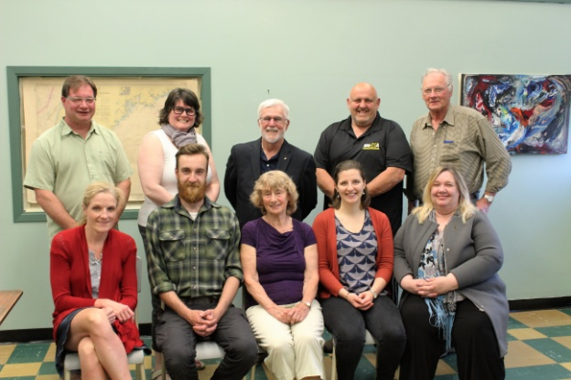
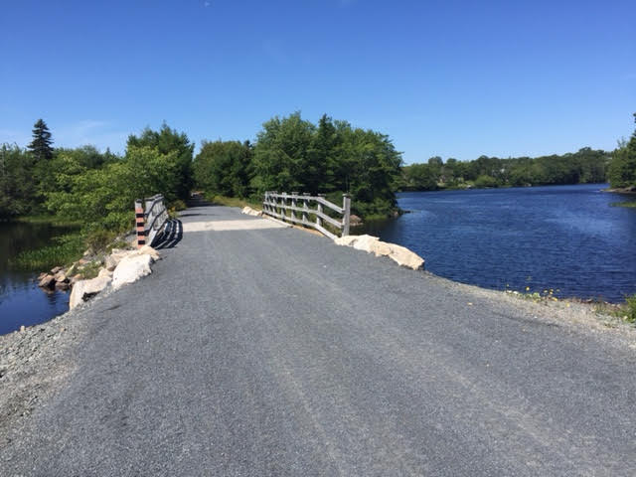
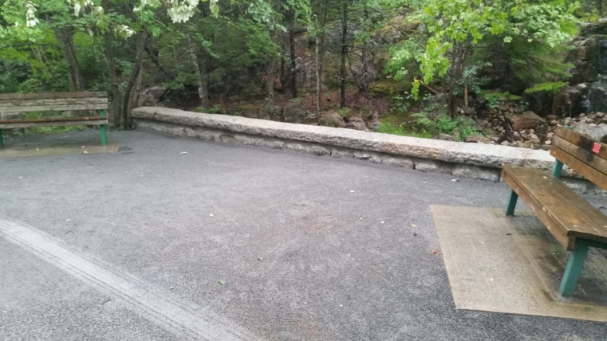
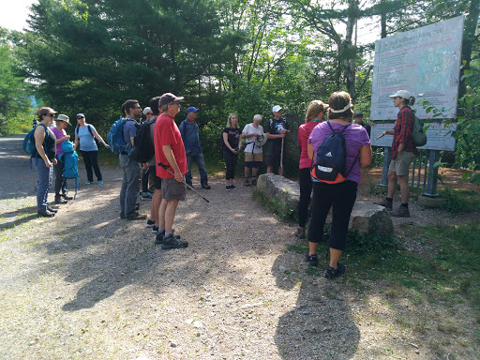
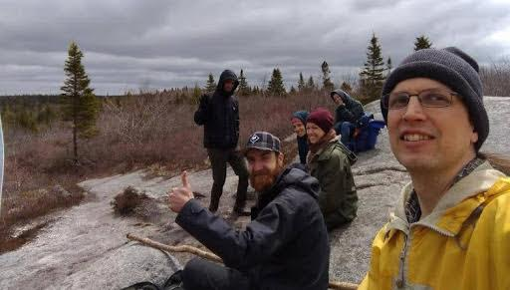
Report from the Chair
Environmental Stewardship Grants Program
Notes:
In June, we proudly launched an exciting new Grants Program that awarded funding to boots-on-the-ground organizations ready to tackle projects that benefit the community.
Forty thousand dollars was awarded in 2017 for things like bridges, trail erosion repairs, and training new trail stewards. All improvement projects were right here in the St. Margaret’s Bay area. Our thanks to Tom Musial and the members of the Five Bridges Lakes Wilderness Stewardship Coalition who helped us get the Grant Program off the ground and helped the Trust vet the applications.
This project is made possible with the use of funds raised by FBWHT as a partner in the Bay Treasure Chest.
The tradition continues and we are proudly accepting applications for the 2018 Grants Program and encourage you to see our website and online application for more details.

Slide 7
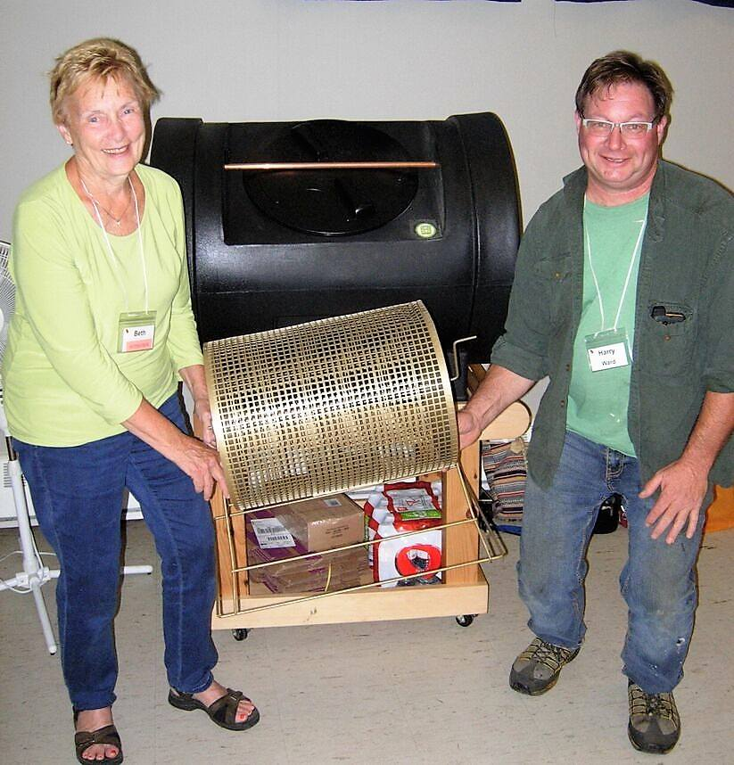
Report from the Chair
Bay Treasure Chest
Notes:
Bay Treasure Chest…..Continues to be a wonderful partnership for the Trust.
Funding from this program has allowed us to achieve things that would have otherwise remained on our wish list.
Almost everything we do is made possible with this funding:
- Hiring Communications and Book Keeping support
- Completing the Nine Mile River Bridge Project
- Publishing the Walking Guides
- Improved signage at the boundaries of the wilderness area
are a few great examples of how the Trust uses this funding.
We look forward to another successful year as part of the Bay Treasure Chest.
Long-time member and Board Advisor Beth McGee (Wave to Beth) is acting as our volunteer Count Supervisor and if ever you have a Wednesday afternoon free and would like to join as a volunteer at the Count, please let Beth know. We are often looking for more help on those busy, but fun days.

Slide 8
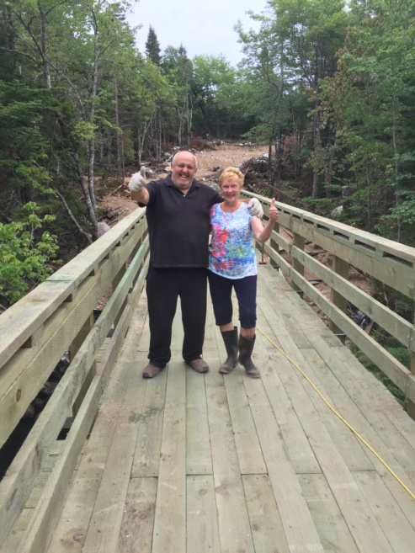
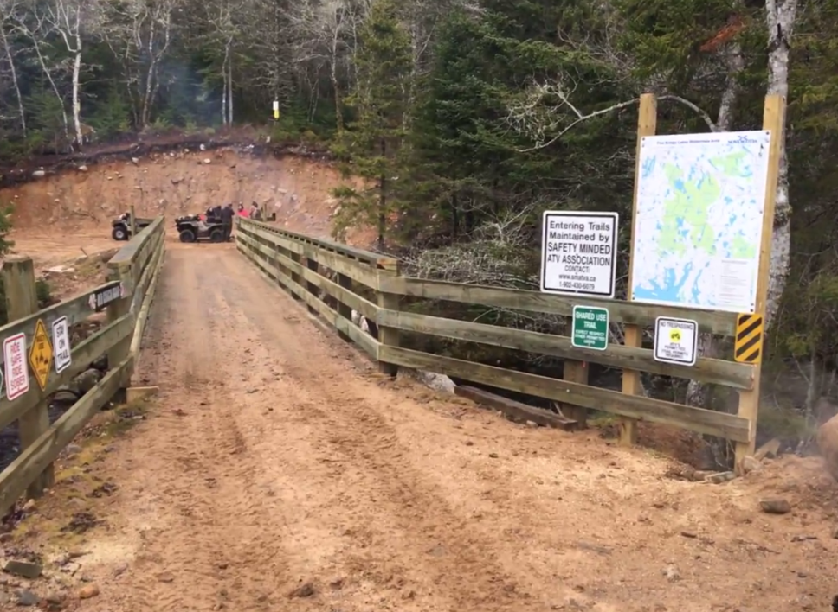
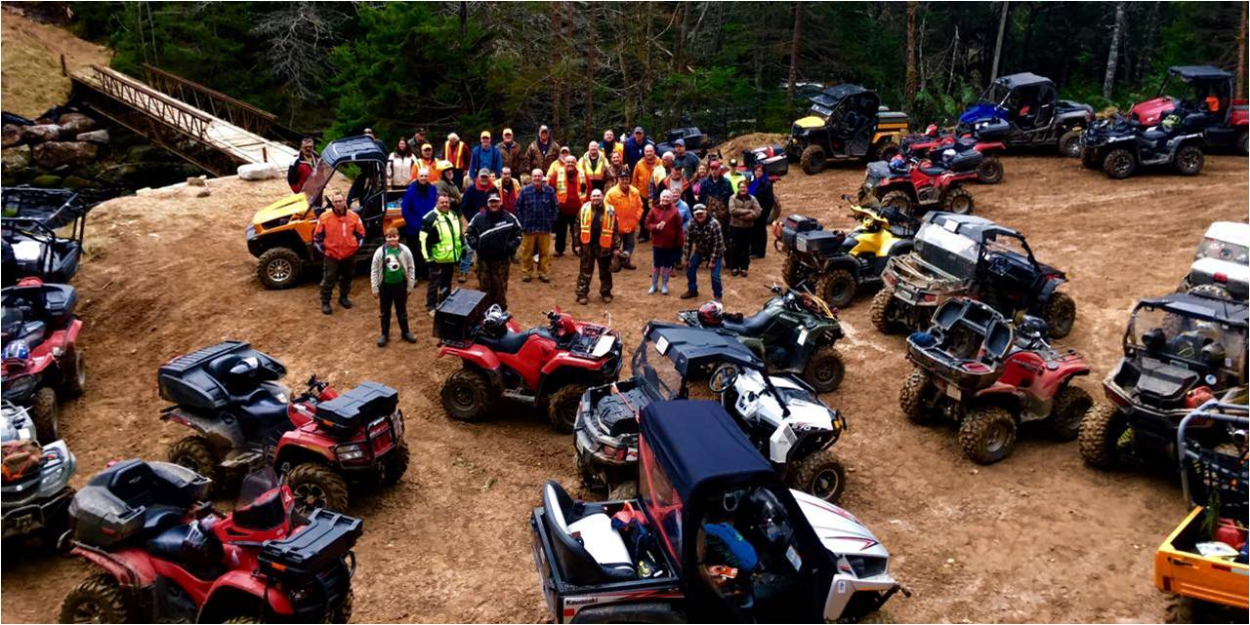
Report from the Chair
Nine Mile River Bridge
ATV Ride or hike to the bridge -
Celebration event Saturday, June 23
Notes:
The Nine Mile River Bridge is installed and we’ll be celebrating on Saturday, June 23 and you are all invited to join us. The Safety-Minded ATV Association will provide rides out to the site which is a 9km route from Goodwood. Mark your calendars and watch for more details closer to the date.
This project was 5 years in the making. The new steel structure is 66 feet long and replaces a wooden one installed in the 1980’s. It will provide safe trail access for years to come.
Volunteer hours on this project are in the thousands when you factor in the fundraising, seeking partnerships, design, planning, delivery, assembling on site and finally installation.
Our thanks to Trust Board Member and President of the Safety-Minded ATV Association Mike Marriott who led the project and will be a big part of planning the celebration event.
Project funding was provided by:
Provincial Connect2 Grant, Off Highway Vehicle Infrastructure Fund, the Bay Treasure Chest,
HRM Councillor Matt Whitman, Prospect Road Recreation Association, ATV Association of NS,
National Trails Coalition and Health Promotion and Protection.
Without everyone’s contribution of time and effort, this trail improvement would not have been accomplished.
---------------------
That concludes the Report from the Chair. Can I have a motion to approve the report? Seconder? Motion Carried.

Slide 9
REPORT of NOMINATING COMMITTEE 2018 BOARD of DIRECTORS
Continuing Board Volunteers:
Two Years Remaining:
Bridget Adams
One Year Remaining:
Peter Lund
Mike Marriott
John Bignell
Harry Ward
Notes:
Next is the Report from the Nominating Committee, which Mike Marriott will deliver.
(Harry steps aside and Mike takes the podium)
Volunteers are the body and soul of this organization.
We are thankful to these people everyday for their contributions.
The by-laws provide for Trustees to be elected for 3 years.
The following terms remain to be served.
2 Years Remaining: Bridget Adams
1 Year Remaining: Peter Lund John Bignell and Myself (Mike)
Harry Ward

Slide 10
New Board Nominees
Imbert Allen
Wayne Rogers
Notes:
We have two Members who have put their names forward to become Board Members:
Imbert Allen and Wayne Rogers
I open the floor at this time to welcome any others interested in volunteering for a Board position? We would love to have you join us. The by-laws provide for a minimum of 5 and a maximum of 15 Trustees. Any others interested in volunteering?
(Wait for new volunteers to stand. If no one comes forward..) Any others interested in volunteering? (Must be asked 3 times)
Welcome Imbert. Welcome Wayne.
(If someone comes forward ask them to provide their name which we’ll write down)
(If there are more than 8 volunteers coming forward from the floor, a vote has to be arranged. Secret ballots should be shared with members (yellow slips).
Members only write the names of their choice for Board Trustee positions. Only the first five names on each ballot will be counted. The Chair of the meeting will now accept nominations from the floor. The Chair of the meeting will appoint two people to count the ballots. Following announcement of the results, the chair of the Nominating Committee will move that the ballots be destroyed.)
This concludes the report from the Nominating Committee. Can I have a motion to approve? And a seconder? Motion carried.
(Mike leaves the podium)

Slide 11
Volunteer Appreciation
Notes:
(Harry at the podium)
We have a couple of special volunteers to thank today and make special mention.
Gary Armsworthy has been a valued legal advisor to the Trust since 2003. He continues to join us at Board meetings, review our materials and provide solid advice that we are so thankful for. Gary we appreciate the time and dedication you’ve shown the Trust over the years. (Give Gary certificate and get photo taken)
We would also like to thank Trust Advisor Jeff Parks who did the Walking Guide layout and the wonderful maps. This was no easy task and we thank you Jeff for your wonderful work. As thanks, we are providing an Honourarium to Scouts Canada, Jeff’s other volunteer family. Come on up Jeff!
(Give cheque and pose for quick photo with the big cheque) Harry stays in front. John Bignell moves to the podium.
Thanks to you all.

Slide 12
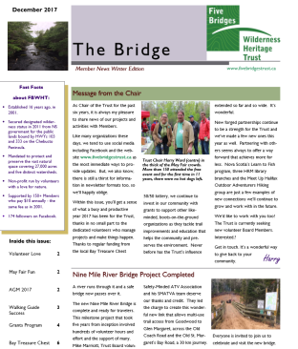
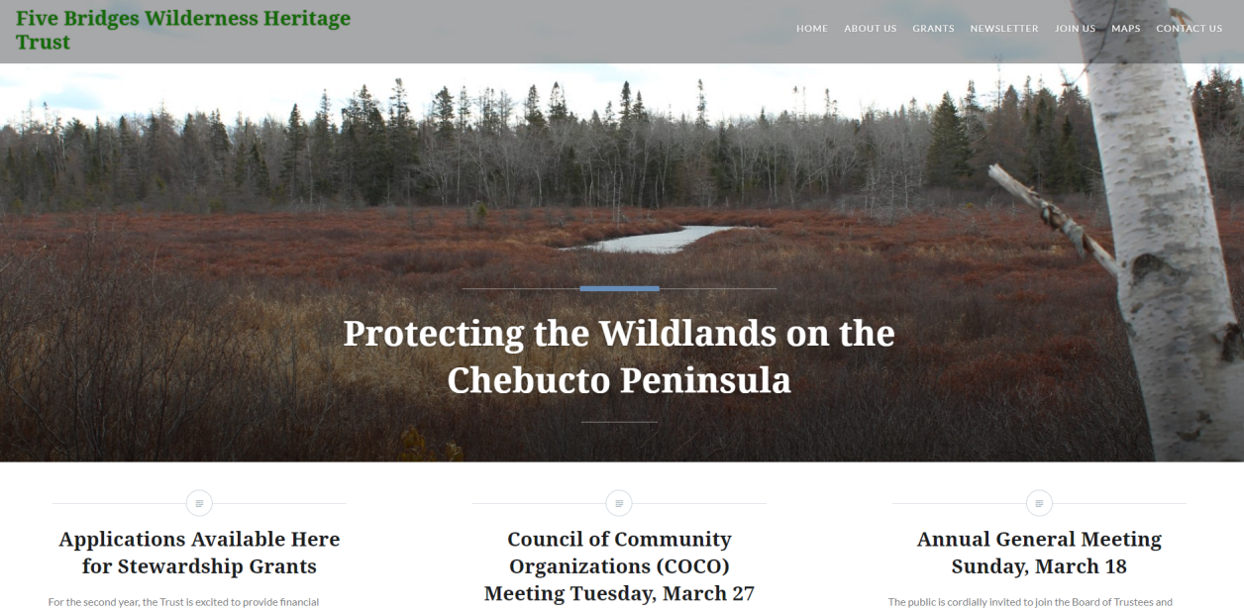
News and Community Sharing
Communications Update
www.fivebridgestrust.ca
Notes:
We love to share the work of the Trust and try to keep members informed of our activities. Please follow us on Facebook and visit our Website to see the latest stories and updates. (Spell it out) www.fivebridgestrust.ca
Our newsletter The Bridge is also circulating here today and available online.
Dates to remember:
Two events at Jerry Lawrence Park that may interest you:
May Fair in the Park is Sunday, May 27.
Warbler Walk is Sunday, June 3.
Nine Mile River Bridge celebration is Saturday, June 23.
We hope you’ll help us spread the news about the Trust and use these prizes we are giving away today. I’ll call on Bridget Adams our Treasurer to pick the winning numbers. If you are interested in purchasing any of our branded items you can see samples at the Membership Table and place an order with Joanne Ellis.
(Bridget comes forward to pull the winning tickets to receive new logo items. Joanne to help with passing them out. Water bottle prizes.)
Jeff LeBoutlier has asked for a few moments to discuss the Ingramport Wilderness Protection Project. He’ll be brief though and then we’ll have a break while we set up our guest speaker. Jeff please come forward.

Slide 13
Special Guest Speaker: Butch Galvez, Dept. of Natural Resources
Notes:
It is my pleasure to introduce our guest speaker Mr. Butch Galvez.
Butch has worked 15 years with Nova Scotia Department of Natural Resources. The last six years as the wildlife technician for Halifax West district, which includes this and the Five Bridges area. He studied wildlife management at Sir Sandford Fleming College and has a keen interest regarding human-wildlife co-existence. He studied black bears under biologists Lynn Rogers and Jenny Costelo and since the tragic coyote incident in 2009 (Cape Breton Highlands National Park) an increasing component of his job has been Eastern coyotes, namely the increase in sightings and public concern.
A very interesting topic I’m sure we’ll all learn something.
Welcome. Over to you Butch.

