Slide 1
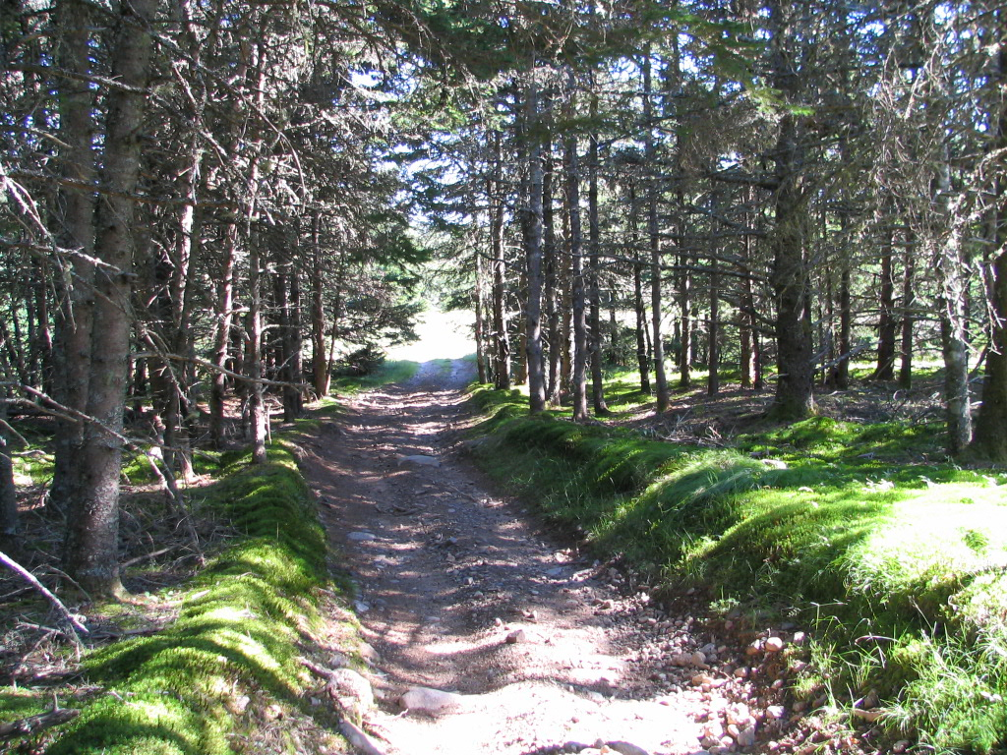
An Archaeological Overview of the Old Greenhead Settlement

Slide 2
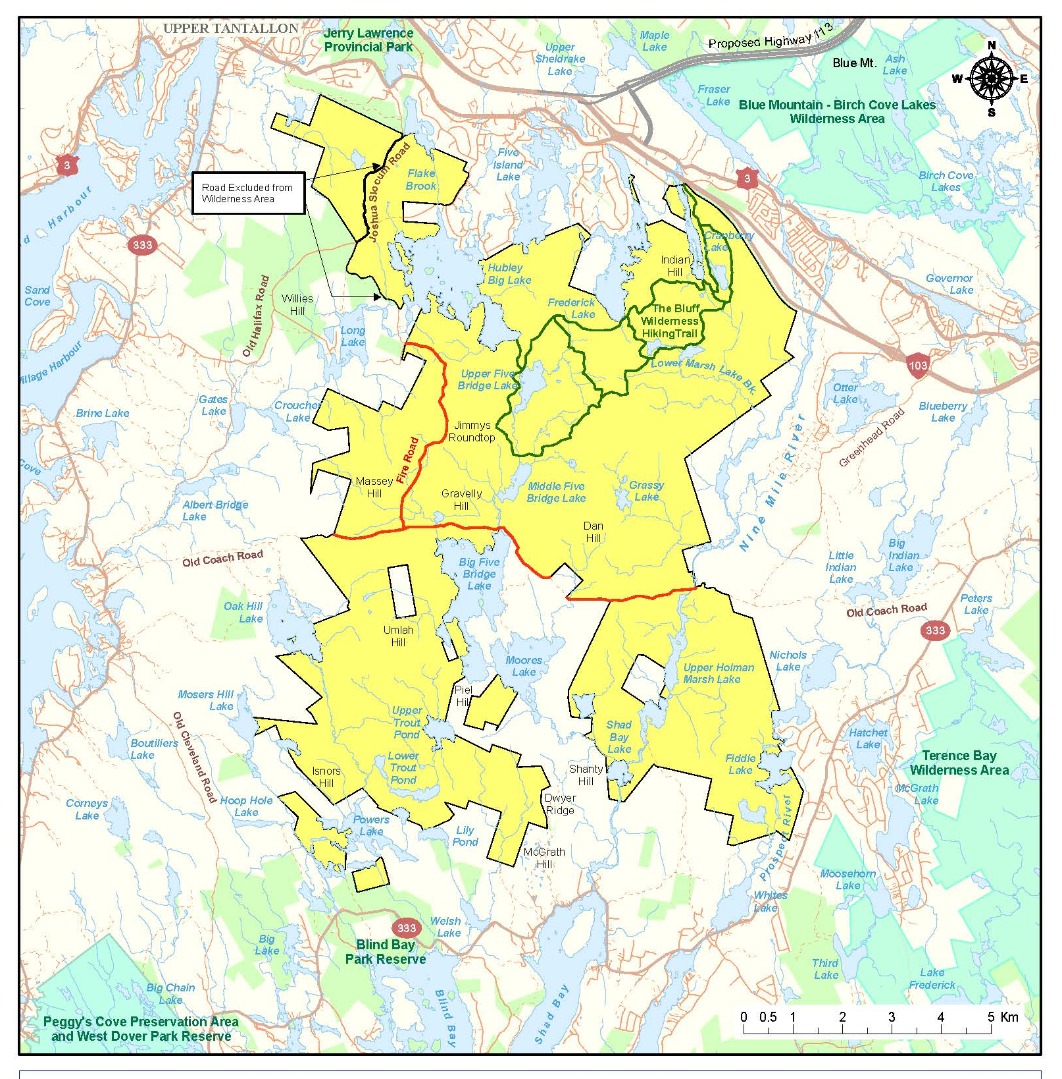
Five Bridge Lakes Wilderness Area

Slide 3
Five Bridge Lakes Wilderness Area

Slide 4
Archaeological Assessments 1991-2015
Nine Mile River

Slide 5
Background Research
Land Grants
C. Drysdale
1811 – 200 acres
William Umlah
1821 – 100 acres
James Drysdale
1833 – 70 acres
John Carmichael
1868 – 188 acres888

Slide 6
Five Bridge Lakes Wilderness Area
Church 1865

Slide 7
Five Bridge Lakes Wilderness Area
Faribault 1908

Slide 8
Archaeological Reconnaissance

Slide 9
J. Drysdale Farm Site
Archaeological Reconnaissance
Greenhead Road East 1 Site

Slide 10
Archaeological
Reconnaissance
Results of initial
Field Truthing
(1991)

Slide 11
Charles Drysdale Farm Site
1811
James Drysdale Farm Site
1833

Slide 12
Greenhead Cemetery

Slide 13
Greenhead Cemetery

Slide 14
Greenhead Cemetery
In Memory of
James Umlah
Died
Nov 17, 1867
Aged 66 Years

Slide 15
Umlah Cemetery
Martha, wife of James Umlah, who died in 1895 and son George, who died in 1883.

Slide 16
Carmichael Cemetery

Slide 17
Carmichael Cemetery
Father and Mother
Sacred to the Memory
of
John Carmichael
Died
April 5 1884
Aged
73 Years
Elizabeth Carmichael
Died
July 20 1890
Aged
79 Years
Northern Marker

Slide 18
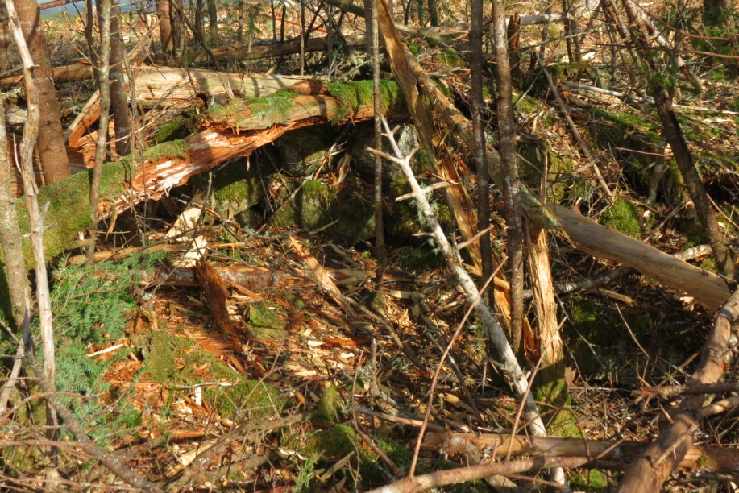
Carmichael Farm Site

Slide 19
Carmichael Farm Site

Slide 20
Resource Protection
Umlah Cemetery
Carmichael Farm Site

Slide 21
Church 1865

