Slide 1
Five Bridges Wilderness Heritage Trust Annual General Meeting
March 5, 2017
Estabrooks Community Hall
Lewis Lake
Notes:
Welcome. I’d like to bring the meeting to order.
For those who don’t know me, I’m Harry Ward, Chair of the Five Bridges Wilderness Heritage Trust.
So pleased to see so many familiar faces here today and some news ones I look forward to meeting.
So welcome everyone.
(Politicians in the crowd? )
Welcome to.....

Slide 2
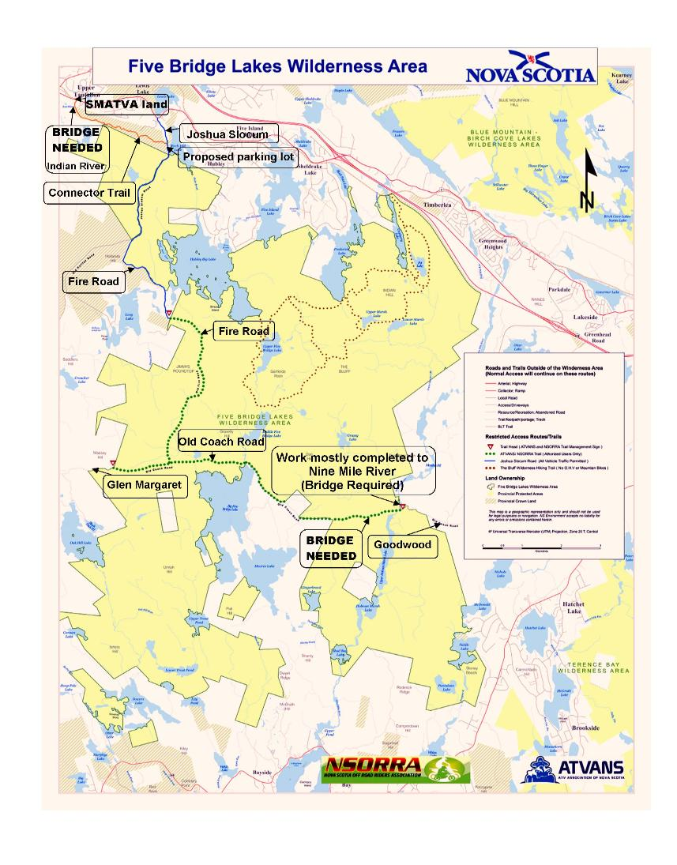
Agenda
Approval of Agenda
Approval of Minutes
for 2016 AGM
Treasurer’s Report
Report from the Chair
Report from the Nominating Committee
Guest speaker:
Bruce Stewart
Adjournment
Notes:
Here is our Agenda for today’s AGM meeting.
Can I have a motion to approve the agenda?
Seconder?
Motion carried.

Slide 3
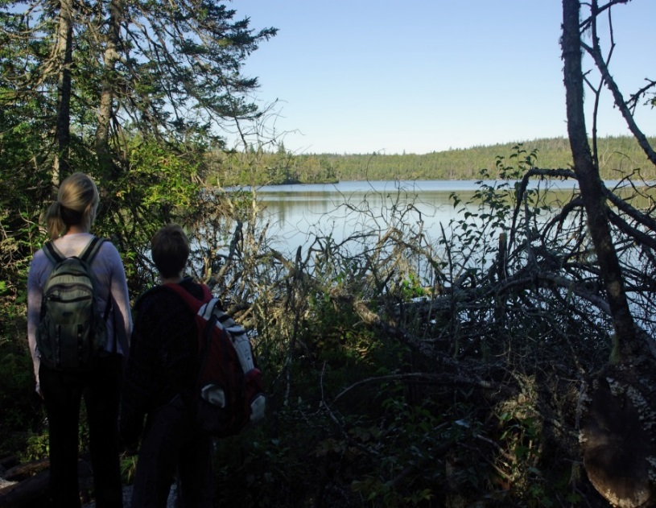
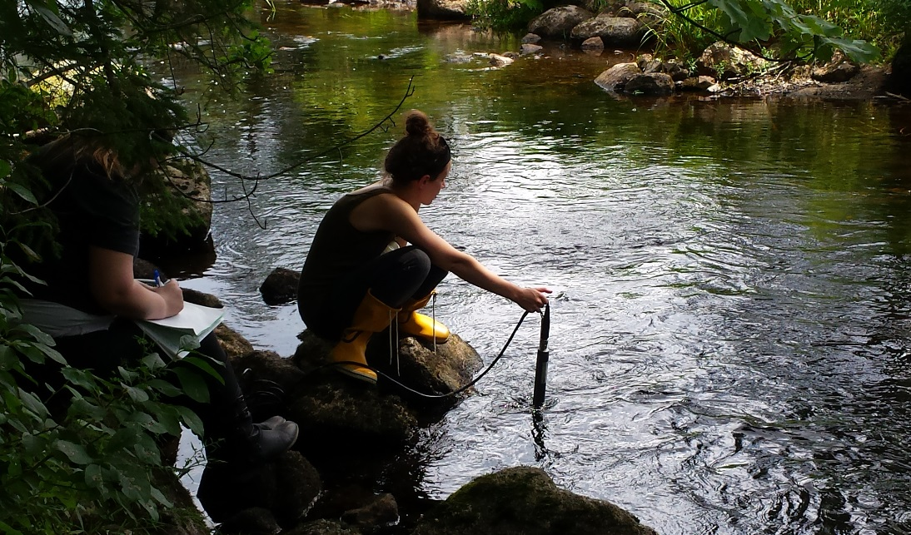
Approval of Minutes for 2016 AGM
Watch…Listen….Learn…Teach
Notes:
The Meeting Minutes for the 2016 AGM have been presented.
Can I have a motion to approve last year’s Minutes?
Seconder?
Motion carried.

Slide 4
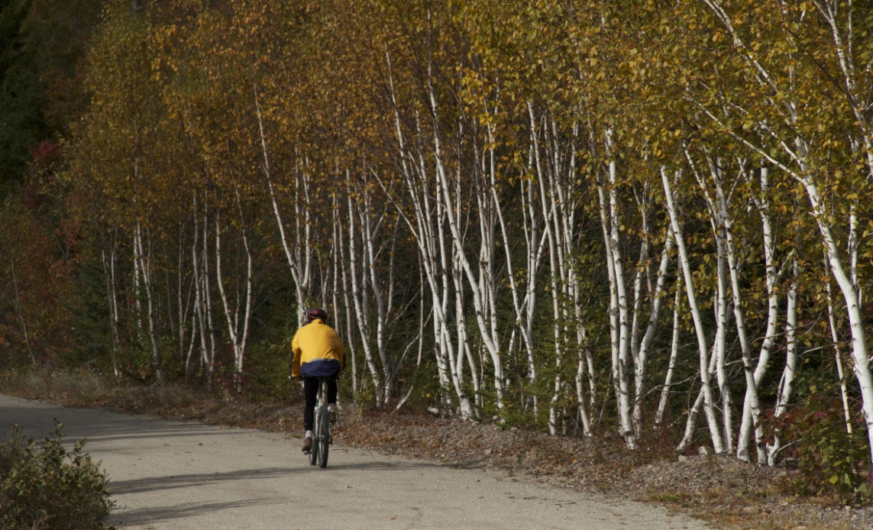
Treasurer’s Report
Notes:
Copies of our Financial Statements for 2016 are available.
Let me run through the highlights.
Can I have a motion to approve the Treasurer’s Report?
Seconder?
Motion carried.

Slide 5
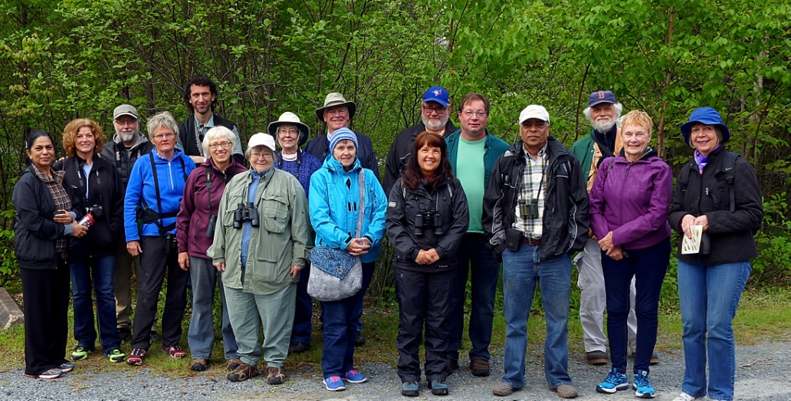
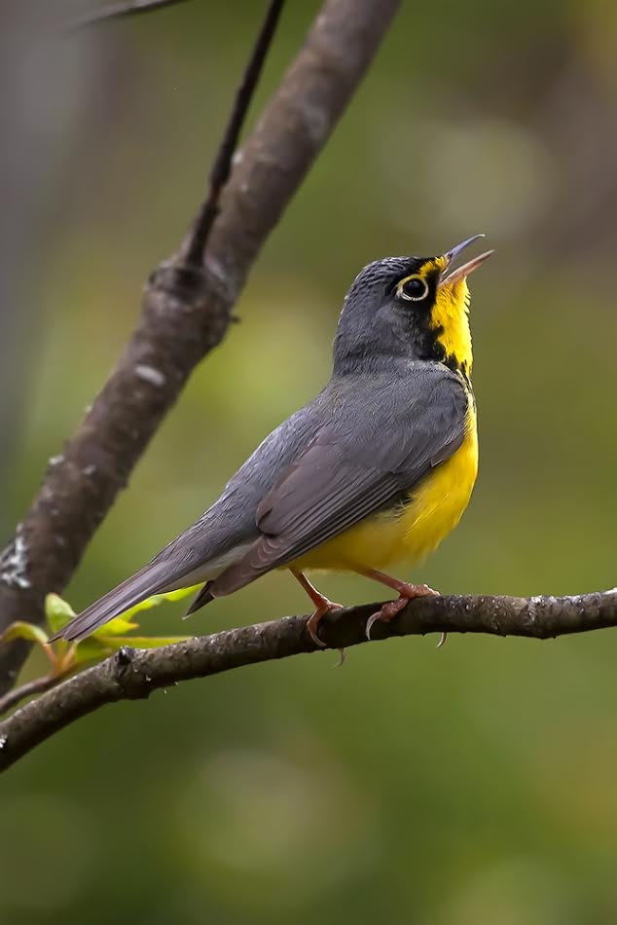
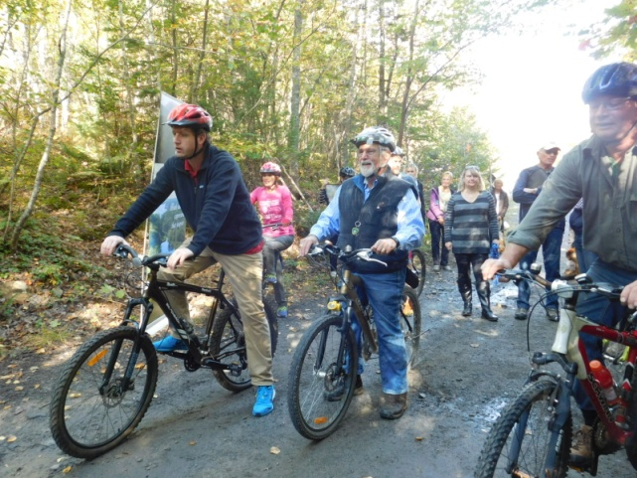
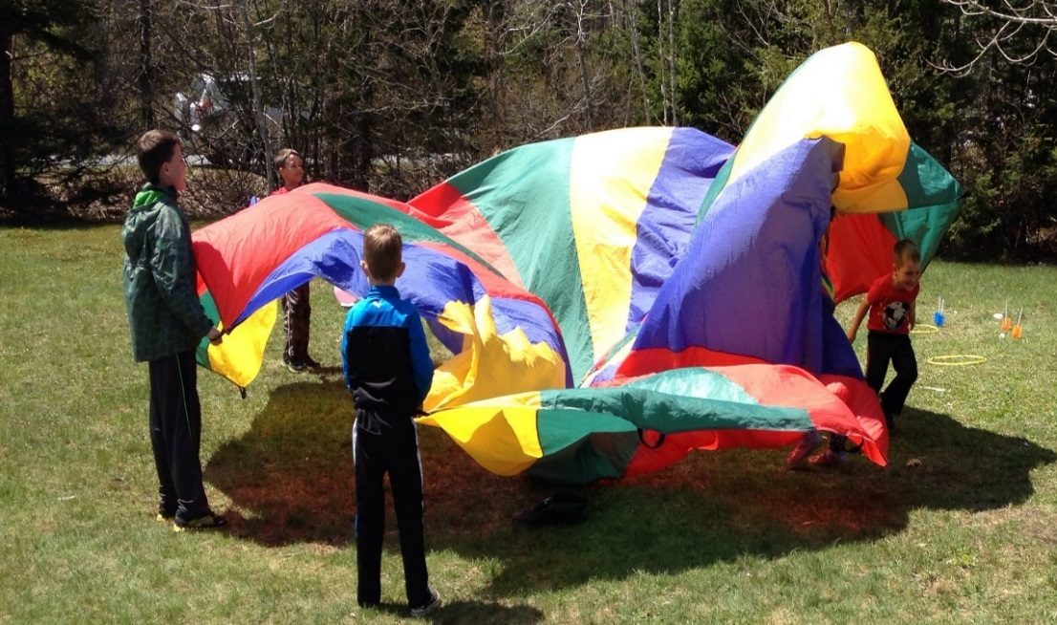
Report from the Chair
Members – Join us
Walking Guide
May Fair
Warbler Walk
Cyclers Welcome
Notes:
As the Trust Chair, I get to share the great work of our volunteer team. But, we really are a team and we have a lot of fun. We certainly learn new things, make new friends and get great satisfaction from accomplishing our work. If you are interested in joining us a volunteer, we would love to have you. That’s my pitch. Now on with the news!
We are preparing to reprint the book A Walking Guide to the Old St. Margaret’s Bay Road. This great resource offers wilderness area explorers directions, maps and explains the history of the area, which runs from Glen Margaret to Goodwood across a road that was built more than 200 years ago. Free copies will be made available to libraries, schools and community groups to encourage appreciation of the wilderness area. If you have old photos from an earlier time that depict life along the Old St. Margaret’s Bay Road we’d love to talk to you. See Beth McGee or Joanne Ellis.
Last year, we hosted our 10th Annual May Fair in the Park at Jerry Lawrence Provincial Park.
With help from local avid birder, Hans Toom we also hosted the annual Warbler Walk event at Jerry Lawrence, which happens to be a key nesting site for warblers in Nova Scotia.
We hosted a ribbon-cutting and celebration with cyclists to mark the NS Environment decision to welcome bikers to the wilderness area trails, especially those trails already in use by ATVs.

Slide 6
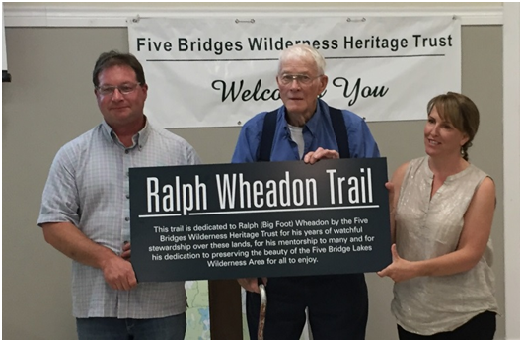
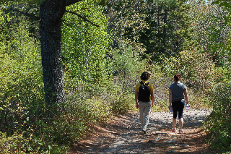
Report from the Chair
Ralph Wheadon Trail
Environmental Stewardship Grant Program
Deadline for applications: April 1st
Notes:
Celebrating our advisors and volunteers is really important to the Trust.
Last year, we had a chance to honour Ralph Wheadon, a long-time resident and the area’s first forest ranger. A section of trail is now named in his honour.
You may recall that Beth McGee was honoured at our last AGM. We didn’t put up her sign -- McGee’s Crossing-- until Ralph’s went up. So there is lots of respect there between our special volunteers. We recognize and thank them both again for all they’ve done for the Trust.
We are launching an exciting new Environmental Stewardship Grant Program that allows community members or groups to receive funding for projects that align with the Trust’s objectives.
This new program is made possible through funds received by the Bay Treasure Chest.
10 thousand dollars has been earmarked so far. The deadline for this first round of applications is April 1 and the theme of this round of grant applications is trail development. See details on our website.
In order to ensure a fair procedure for awarding stewardship grants, the Trust entered into a service agreement with the FBLWA Stewardship Coalition to vet applications and avoid conflict of interest. The agreement and accompanying checklist for submitting grant applications were developed over a period of nine months. Under this agreement, the Trust retains full responsibility for approving all awards and administrating all funds. We look forward to the great things that will come out of this new grant program.
We are working closely and will continue to keep NS Environment aware of our grant program activities.

Slide 7
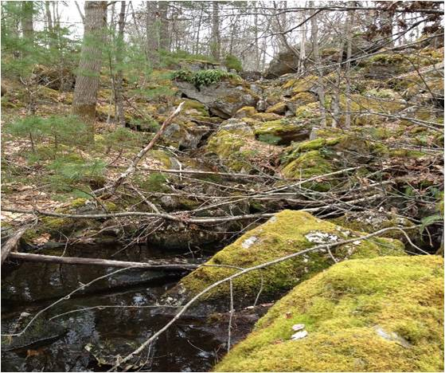
Report from the Chair
Bay Treasure Chest
Notes:
Continues to be a wonderful partnership for the Trust.
Funding from this program has allowed us to achieve things that would have otherwise remained on our wish list.
Great examples of projects funded in 2016 include:
- Water sampling on the Nine Mile River,
- Hiring two summer students for project work, a partnership achieved with St. Margaret’s Bay Stewardship Association,
- Creating and posting new signage partnered with St. Margaret’s Bay Rails to Trails.
We look forward to another successful year as part of the Bay Treasure Chest.

Slide 8
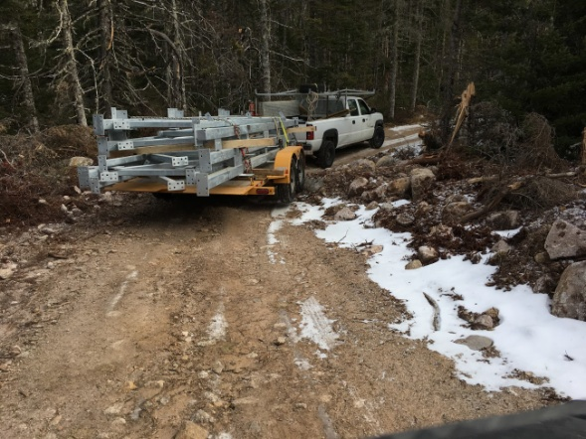
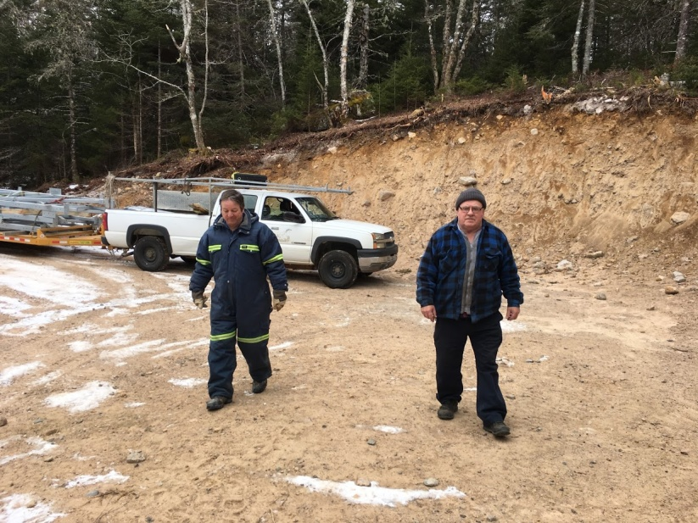
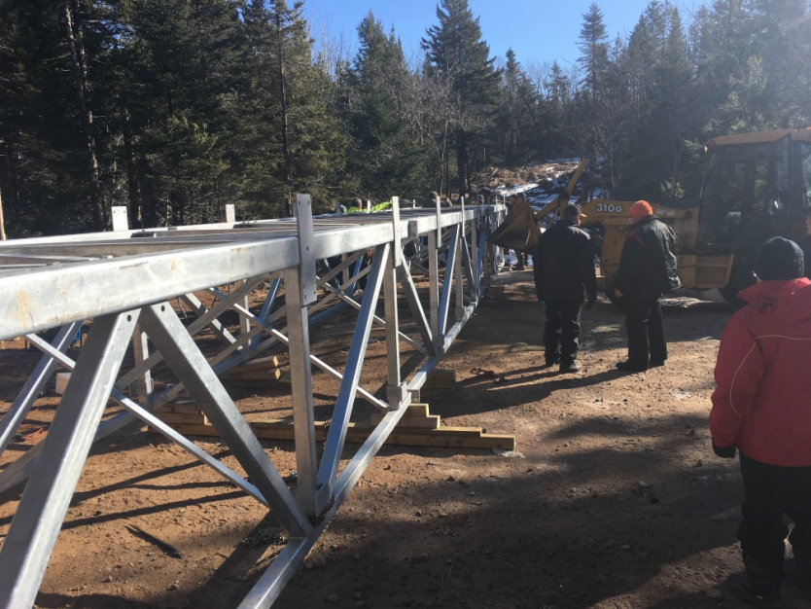
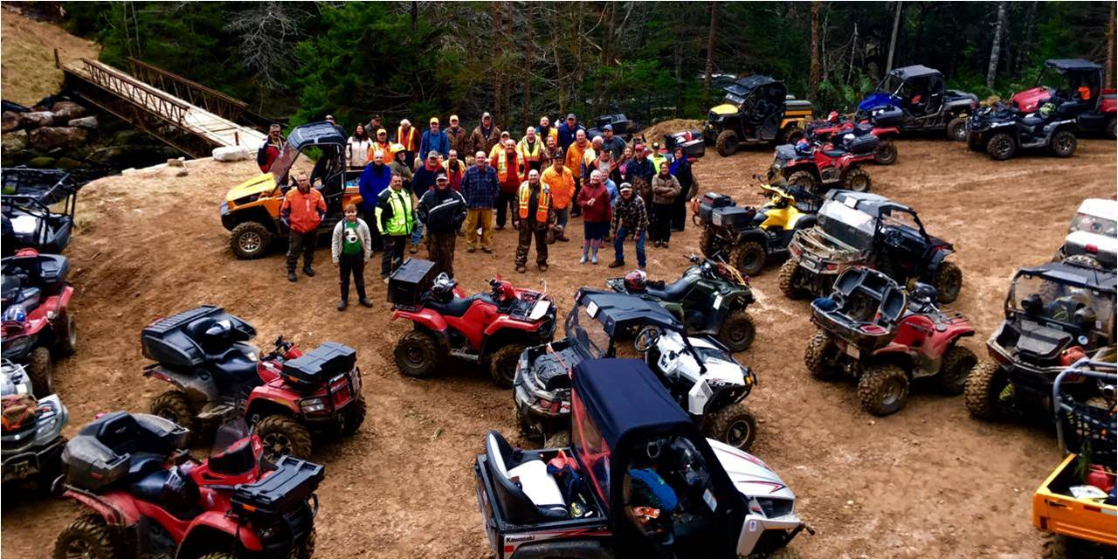
Report from the Chair
Nine Mile River Bridge
Notes:
The Nine Mile River Bridge is a significant project for the Trust for several reasons.
5 years in the making. The new steel structure is 66 feet long and replaces a wooden one installed in the 1980’s. It will provide safe trail access for years to come.
Volunteer hours on this project are in the thousands when you factor in the fundraising, seeking partnerships, design, planning, delivery, assembling on site and finally installation.
I hope you all have a chance to visit the new Nine Mile Bridge when you are out this spring and summer.
Trust Board Member Mike Marriott led the project. Funding was provided by:
Provincial Connect2 Grant, Off Highway Vehicle Infrastructure Fund, the Bay Treasure Chest,
HRM Councillor Matt Whitman, Prospect Road Recreation Association, ATV Association of NS,
National Trails Coalition and Health Promotion and Protection.
Special thanks to Iain Rankin (MLA Timberlea-Prospect), ATVANS/ trails coordinator Corey Robar and our local Safety-Minded ATV Association members.
Without everyone’s contribution of time and effort, this trail improvement would not have been accomplished.
---------------------
That concludes the Report from the Chair. Can I have a motion to approve the report? Seconder?
Motion Carried.

Slide 9
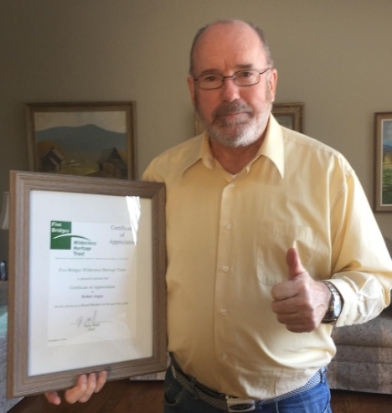
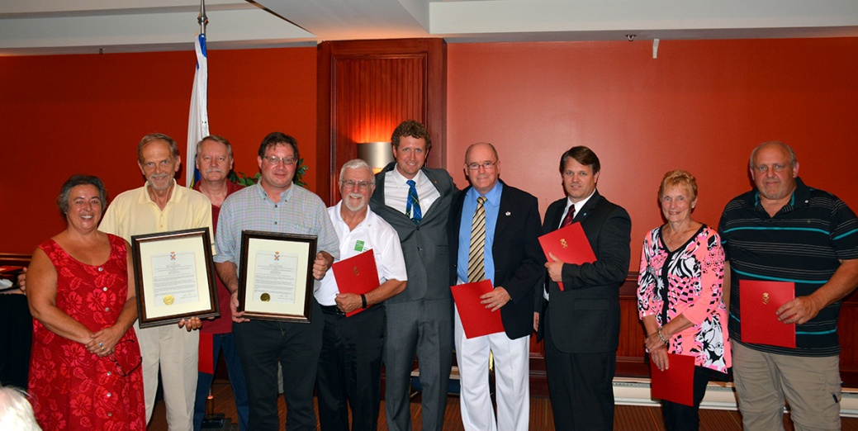
REPORT of NOMINATING COMMITTEE 2017 BOARD of DIRECTORS
Continuing Board Volunteers:
Two Years Remaining:
Peter Lund
Mike Marriott
John Bignell
One Year Remaining:
Harry Ward
John Cascadden
Moving to Advisor Status:
Barbara Allen
Beth McGee
Bob Angus
Notes:
Next is the Report from the Nominating Committee, which Trust Board Member John Cascadden will discuss.
Volunteers are the soul and body of this organization.
We are thankful to these people everyday for their contributions.
The by-laws provide for Trustees to be elected for 3 years.
The following terms remain to be served.
2 Years Remaining: Peter Lund Mike Marriott John Bignell
1 Year Remaining: Harry Ward and Myself
We have three people moving off the Board to Advisor Status. Bob Angus, Beth McGee and Barbara Allen. Three friends we will miss for sure.
On behalf of the Trust, we would like to extend our sincere thanks and heartfelt best wishes to all three of you. We have a certificate to show our appreciation. Please come forward Barb Allen and Beth McGee.
Bob Angus received his earlier and is in the slide show.

Slide 10
New Board Nominees
Bridget Adams
Pamela Lovelace
Melinda Spooner
Notes:
We would like to welcome three new nominees: (WAVE TO THEM AS THEY STAND)
Bridget Adams, Pamela Lovelace and Melinda Spooner.
Are there any others interested in volunteering for a Board position?
The by-laws provide for a minimum of 5 and a maximum of 15 Trustees.
(If there is no one else volunteering, welcome those three new members).
(If there are more than 3 volunteers coming forward from the floor, a vote has to be arranged. Secret ballots should be shared with members (yellow slips).
Members only write the names of their choice for Board Trustee positions. Only the first five names on each ballot will be counted. The Chair of the meeting will now accept nominations from the floor. The Chair of the meeting will appoint two people to count the ballots. Following announcement of the results, the chair of the Nominating Committee will move that the ballots be destroyed.

Slide 11
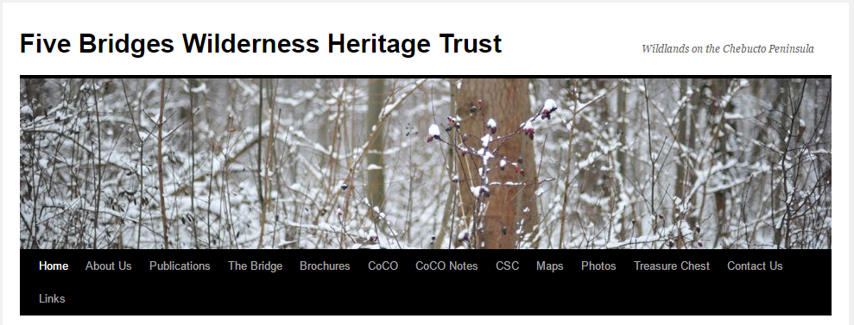
News and Community Sharing
Communications Update
Community
Announcements
www.fivebridgestrust.ca
Notes:
We love to share the work of the Trust and the news of other community organizations. Follow our Facebook page and our Website to see the latest updates.
Our newsletter The Bridge is also circulating here today and available online if you’d like more details about our activities.
Community Announcements:
The Otter Lake Landfill Community Monitoring Committee (CMC) is hosting a public meeting Thursday, March 9 at 6:30 p.m. at the Prospect Community Centre.
The Council of Community Organizations (CoCO) is an important forum to share community intelligence. The next meeting Thursday, March 23 at
7 p.m. Lakeside Community Centre. Woodens River Watershed Environmental Organization (WRWEO) is hosting.
Micou’s Island Stewardship Day – Saturday, March 25 from 12:30 pm to 4pm
St. Margaret’s Bay Stewardship Association AGM -- On Sunday, March 26th from 2 until 4 PM at the St. Margaret Sailing Club
May Fair is Sunday, May 28th.
Warbler Walk is Sunday, June 4.
----------------------------------------
Any questions on the topics we’ve covered this afternoon?
----------------------------------------
Fred Dolbel would like to discuss the CEC-Community Enterprise Centre. Over to you Fred.

Slide 12
Our New Economy in St. Margaret’s Bay
ONE SMB community workshop Nov. 15, 2014
Reviewing the Ivany report to build a prosperous
future brought forth the following initiatives
● Economical Housing and Trail Development
● Branding St. Margaret’s Bay
● Connecting Communities
● Home Based Business
● Multi-use Community Space
● Engaging Youth
● Vital Signs
→ a SMB Community Enterprise Centre
to serve and network SMB volunteer organizations with local business.

Slide 13
St. Margaret’s Bay Community Enterprise Centre
Volunteers
Local Business
Community Service Groups
Chamber of Commerce
HRM Volunteer Services
HRM Community Space
Entrepreneurship and Business Development Agencies
Community Enterprise Centre
Developing resources and skills beyond the scope of individual groups.
Enhanced support services for residents and visitors
Employment and services for local residents

Slide 14
A Community Enterprise Centre (CEC) where St. Margaret’s Bay service groups and local businesses network together for local prosperity.
Key features:
Drop-in conversation, socialization and networking space
Permanent location for Not-for profit members
Social enterprise and entrepreneur resources
Serviced office and meeting spaces
Participation by Development Agencies
for delivery of training programs
for access to funding and grant programs
Delivery of government services in SMB

Slide 15
CEC User plans:
Plan A – Full time access to CEC facilities
One year agreement
Dedicated space (24/7 access)
All office equipment supplied
Can nominate 1 person for election to BoD
Plan B – Reserved space and access to CEC
One year agreement
Reserved space
Some office equipment supplied
Can nominate 1 person for election to BoD
Plan C – Pre-booked use of CEC
One month agreement
Minimum one day agreement
Assigned workspace
Negotiated use of amenities
Plan D – Drop-in use of workspace
Hourly rental – meeting and/or workspace
Assigned workspace
Negotiated use of amenities

Slide 16
Conceptual EXAMPLE only - for discussions
Need more private/secure storage spaces !
NOT TO SCALE
Shared office #2
- Treasure Chest
- Stewardship
- Mentoring
- Local business
- Shared usage
Meeting and Board room
- community groups
- business bookings
- entrepreneurial training & seminars for individual businesses and/or volunteer groups eg. Marketing, Management, Communications, other skills .....
Storage
Accessible Washroom
(eg. locked file cabinets, office supplies, computer station, .... )
Shared office #1
- Chamber of Commerce
- Seniors
- Tourism
- Bay Rides
- Connecting Communities
‘Kitchen meeting’ area
- scheduled/unscheduled
- drop-in activity area #2
-
C
o
f
f
e
e
(eg. locked cabinets, computer, printer .... )
Community Reception Desk
- General - Tourism
- Local business directory
- Community services
- Seniors assistance
Open area / overflow space
- art exhibits
- short term display space
- expansion area for certain weekly activities
Staffed by scheduled volunteers
- who manage space bookings, office equipment and provide assisted service on request.
Display area
- local art
- local culture
- local artifacts
-
Lounge area
- Drop-in
- planned weekly activities
- casual meetings
- networking
Pamphlet racks
Tourism, community groups, etc.

Slide 17
$ - $$ - $$$
CEC Payment plans:
Plan A – Full time access to CEC facilities
a monthly commitment eg. $100 - $600/month for one year and/or provision of volunteer time and/or other In-Kind service
to provide financial stability to start up the CEC
Plan B – Reserved space and access to CEC
a monthly commitment eg. $100 - $500 for any choice of month/s
to demonstrate part time usage of the CEC
Pre-booked use of CEC
local hall rental for business use runs around
$35-$70/hour and $150+ per half day
local hall rental for non-profit use runs around
$0-$30/hour and $60 per half day
CEC rates will be slightly lower for both the above
Drop-in hourly rental use of a workspace
Rate to be determined eg. $30/hr + consumables

Slide 18
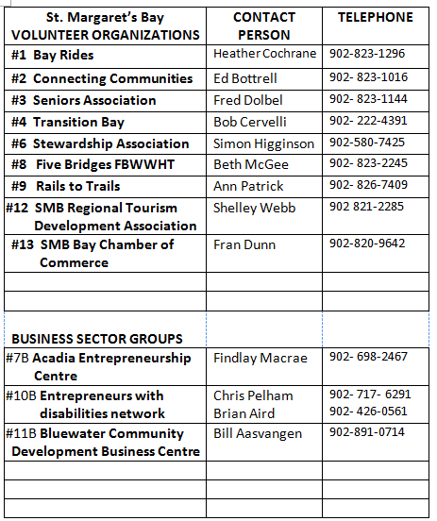
Expressions of Interest – to Feb. 2017

Slide 19
Proceeding from here ...
Letter of Support
Expression of Interest
Letter of Commitment
Signed Plan A user agreement
Signed Plan B user agreement
Participation in securing up
to $5,000 from an HRM Community Development grant. (Deadline is March 31)
For more information please visit
www.smbcec.org/nonprofit.html
CEC proposal_Non-profits v1 Feb. 20, 2017

Slide 20
Special Guest: Bruce Stewart
Notes:
It is my pleasure to introduce our guest speaker Mr. Bruce Stewart.
Bruce has prepared a special presentation for today: “An Archaeological Overview of the old Greenhead Settlement".
He’s a Maritimer that lives in Fall River, born in Truro and raised in PEI.
Bruce is an archaeologist with an Honours BA and Master’s Degree in Archaeology and brings more than 40 years of practical resource management experience to his projects.
Over the past four decades, Bruce has worked as an archaeologist for Parks Canada (Fortress of Louisbourg National Historic Site and Ottawa Locks National Historic Site) and as an archaeological consultant based in Alberta, Ontario and Nova Scotia.
Since incorporating his local company Cultural Resource Management (CRM) Group Limited in 1998, Bruce has undertaken a wide range of archaeological projects for private and public sector clients throughout the Atlantic Provinces and Ontario. Over to you Bruce!

